Slide 1
Building A Foundation for Digital Business
VMware, Inc.

Slide 2
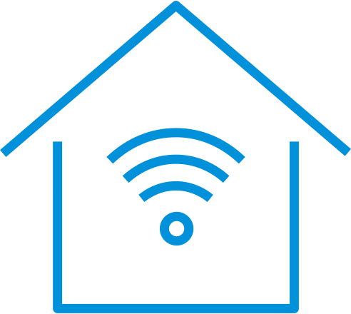




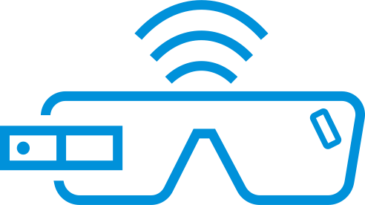
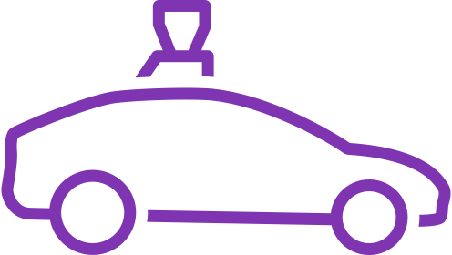
What Do These Mean for Your Business?
New opportunities to create value and deliver new experiences.
New challenges, too.
Notes:
Autonomous vehicles. Smart buildings. Wearables. Commercial drones. New payment methods. What do they all mean for your business?
Opportunities to create new value and deliver great new experiences. They mean new challenges too.
These innovations and many others will impact your business directly by transforming part of your value chain, or indirectly by changing the expectations and priorities of your customers.

Slide 3
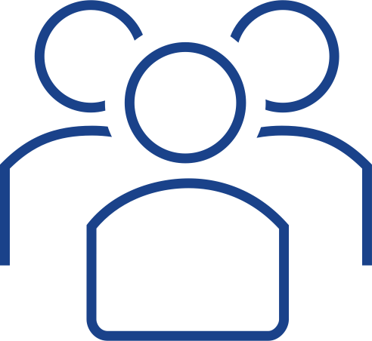
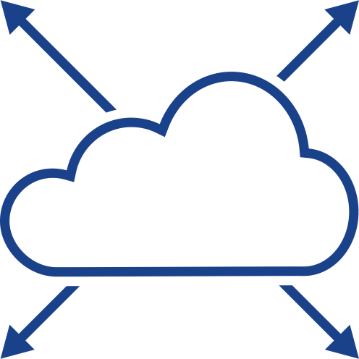
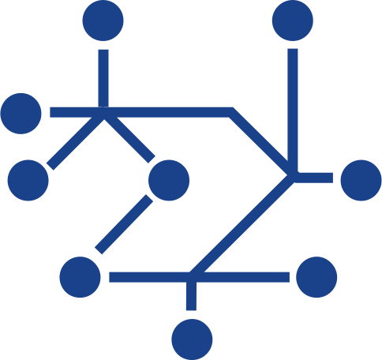
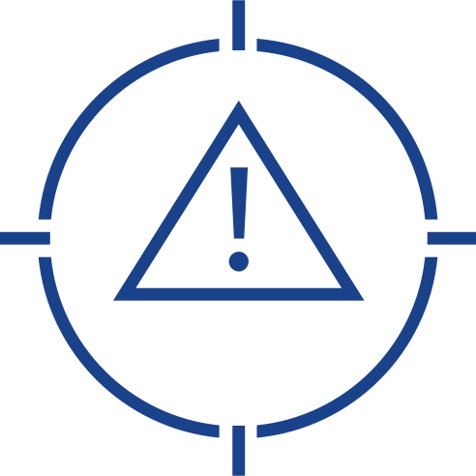

What Do These Mean for Your Business?
Shifting Customer Expectations | Accelerated Disruption | Increasing Complexity | Security Challenges | Budget and Talent Constraints
Notes:
You face increasingly complex trade-offs that will requiring the right investment decisions across your people, processes and technology.
Managing these trade-offs—especially as the speed of disruption and the complexity of technology increase—requires a re-think of IT architecture.
You need an architecture that enables rapid transformation without requiring wholesale disruption.

Slide 4


Enabling Transformation Without Disruption
Digital Foundation
Consistent Infrastructure
Consistent Operations
Intrinsic Security
Notes:
We call our architecture-led, software-defined infrastructure a “digital foundation.”
A digital foundation helps you integrate disruptive technologies with the technologies, processes and people you have now, while ensuring flexibility as technology and business strategies change.
A digital foundation lets you harness new innovations effectively by providing consistent infrastructure, consistent operations, and intrinsic security.
It’s an architecture for transformation on your terms, and it’s essential for navigating the rapid change taking place in every industry.

Slide 5


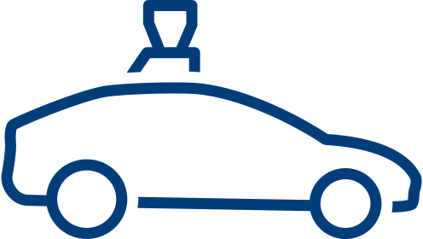



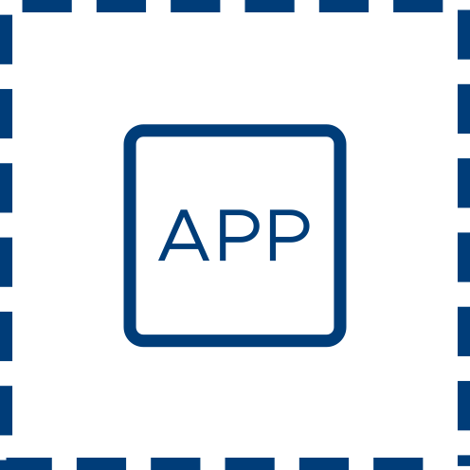
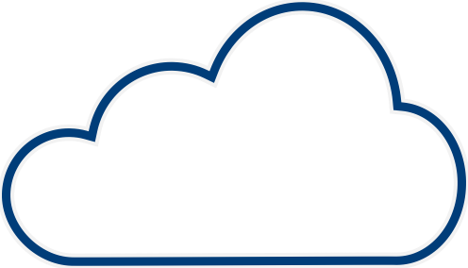

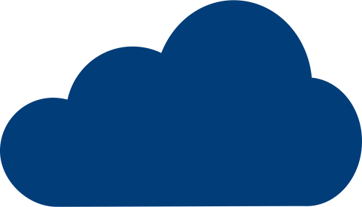

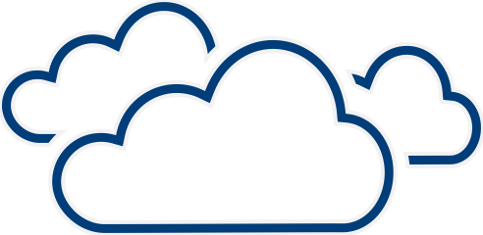



VMware Vision
Deliver the essential, ubiquitous digital foundation
Any Device
Any App
Any Cloud
Cloud Native
Containerized
SaaS
Traditional
Edge Computing
Hybrid Clouds
Public Clouds
Telecom Cloud
Notes:
Our architecture for a digital foundation enables any app, on any cloud, delivered to any device.
“Any cloud” means you can deploy apps to the clouds of your choice, move on-premises apps to the cloud without expensive refactoring, maintain visibility and security of public cloud workloads, and leverage new environments like telco clouds and edge.
“Any app” means you can support the development and operations of cloud and container-based apps, continue to drive cost out of existing on-prem workloads, and even connect existing apps and data sources with new ones to create value in novel ways.
“Any device” means you can easily manage and secure mobile devices, desktops, edge devices and IoT sensors.
Let’s take a closer look.
Any Cloud
VMware is known for virtualizing servers, storage and networks, and integrating them with a management layer, to enable highly efficient and automated private clouds.
Using our integrated stack—whether you consume it as software or an HCI appliance or--means you don’t have to look down the stack and put together individual components, you can look up the stack to focus on delivering applications and business value.
By putting this integrated stack in the public cloud—either Amazon, IBM or dozens of other service providers—we provide the fastest, safest path to hybrid cloud. We’re also bringing this same integrated stack to the edge—which is a lot like a tiny data center—so you can get the benefits of consistent infrastructure and operations there too.
Many of your applications were written for public clouds, so for those apps we provide solutions for consistent operations around visibility, security, governance and automation.
As more telco-enabled services like 5G come along—many of them sitting on top of the VMware stack—you’ll be able to integrate those too, and take advantage of new capabilities like IoT.
Finally, we connect all of these environments together with a software-defined networking layer built for the agility and security needs of the cloud era.
Private and hybrid clouds, edge deployment, public clouds, telco clouds, all connected with a consistent network layer from core to cloud to edge: this enables a true multi-cloud strategy.
You can choose whichever cloud environment best meets your needs, for any application, without giving up visibility, operational consistency, security or control.
Any App
The typical large enterprise has a portfolio of a few thousand applications—and your IT strategy has to support them all.
For existing applications, VMware can help you run them more efficiently, or move them to a cloud environment without having to rewrite them. This means you can focus scarce development resources where they will create the most business value.
To increase the productivity of developers and DevOps teams, VMware’s strategy is to solve the operational challenges around enterprise deployment of containers and Kubernetes by making it as easy and reliable as flipping a switch.
We enable you and your app dev teams to build, operate, and consume container infrastructure on premises or as a cloud service, while addressing the challenges of container security, networking, monitoring and storage.
Any Device
The variety of devices that apps are deployed to continues to grow—much faster than IT teams. At the same time employees are demanding easy, consumer-like experiences from anywhere. VMware enables “consumer simple, enterprise secure” digital workspaces to transform the end user experience while enabling efficient centralized management of user identities, devices and apps.
And of course many endpoints don’t have users—they’re factory floor monitors or security cameras or remote sensors. Our IoT solutions enable gateway and end device management for IoT deployments, again leveraging consistent infrastructure and operations, with intrinsic security.

Slide 6
Application Needs are Driving Cloud Strategies
Existing Apps Reduce Costs | Security | Reliability I Control |  |  | Modern Apps Time to market | Innovation | Scale | Differentiation
Maintain | Re-platform | Hybrid Apps | Re-factor | Develop for Cloud | Replace
SaaS
Notes:
The nature of the applications that power your business has changed dramatically in the last few years.
Not only have apps proliferated, but the types of apps have also diversified.
Apps are now composite in nature, require diverse resources, and run in a wide range of environments.
The ways in which people consume those apps has changed, too, whether in the data center or at the edge, on desktops or with mobile devices.
And for those users, the speed with which you can develop, deploy and continuously improve apps based on ever-changing customer and market needs is essentially synonymous with your perceived “speed of innovation.”
You’re discovering that the right digital foundation puts you in control of the development and delivery of all your apps, whether cloud-native apps in the public or private cloud; hybrid apps; or on-premises traditional apps.
And while these diverse application needs are driving cloud strategies, most of our customers are pursuing a hybrid and multi-cloud strategy.
They’re extending their private cloud to public clouds and increasing their use of multiple public clouds for better scale—and not always intentionally, but in many cases, as a result of consuming readily available apps and services that happen to reside in multiple clouds.
At the same time, they’re trying to make data center operations more and more automated and cloud-like.

Slide 7










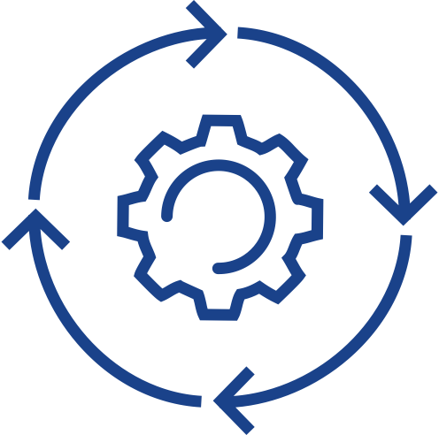


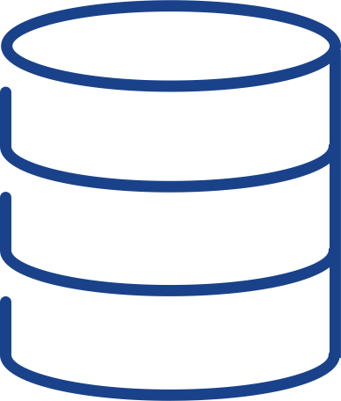
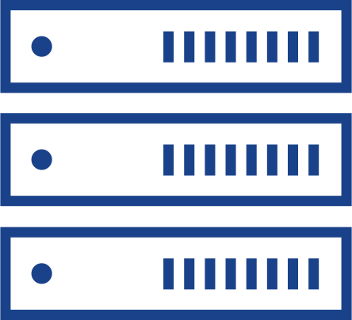
Any Cloud
Consistent Developer Experience
Consistent Operations
VISIBILITY
OPERATIONS
AUTOMATION
SECURITY
GOVERNANCE
CONTAINER MANAGEMENT
Consistent Infrastructure
VM
VIRTUAL MACHINES
CONTAINERS
KUBERNETES
Hybrid Cloud
Native Cloud
VMware Cloud Foundation
VMware Cloud on AWS
IBM Cloud for VMware
VMware Cloud Providers
AWS
Data Center and Public Clouds
Edge
Notes:
VMware’s heritage is enabling customer choice by abstracting different hardware options into a uniform virtualized layer.
We’ve done that for servers, storage, and networks, while enabling automated and policy-driven operations and management, letting you run IT on your terms.
We do the same with cloud.
We let you choose whichever cloud environment best meets your needs, without making you give up visibility, operational consistency, security or control.
We do this by offering a valuable set of cloud solutions for whichever path IT chooses—be that moving existing data center workloads to a hybrid cloud; moving native cloud workloads to the data center or edge; natively managing apps and workloads in multiple public clouds; and developing and deploying new container-based apps on top of enterprise-grade Kubernetes.
Ultimately, we enable you to make the right infrastructure and service choices for your apps and then evolve them over time as your needs change.
[click to build]
Our fully integrated hybrid cloud platform delivers software-defined compute, storage, networking, security and cloud management in both private and public environments.
This simplifies data center operations, bringing the ease and automation of the public cloud in-house with a standardized and validated architecture that features built-in lifecycle automation for the entire cloud stack.
Deployment options include on-premises, as a service from VMware running in AWS, and as a service from dozens of other major cloud providers.
Project Dimension will extend hybrid cloud to the edge as well.
Our hybrid cloud stack also leverages VMware virtualization to provide intrinsic security at every level of the infrastructure, including micro-segmentation at the networking layer, behavioral app-level protection at the compute layer, and data encryptions at the storage layer.
[click to build]
But not all of your workloads are running in virtualized environments. Increasingly, more of your workloads are cloud-native as you start consuming commoditized apps from AWS, Azure, Google Cloud Platform, IBM or any cloud provider.
With industry-leading cloud management and networking and security solutions, we enable common operations and automation for greater visibility and cost management, as well as greater security and better control.
Increasingly intelligent operations management also gives you continuous performance optimizations, efficient capacity management, and intelligent remediation.
[click]
And at the end of the day, you benefit with a developer-friendly environment across clouds, and the ability to help your ops team manage compliance, cost and ongoing cloud operations across a multi-cloud environment in a frictionless way.
Obviously, a key goal of any cloud strategy is to increase the productivity of developers and DevOps teams, who are driving a significant portion of your cloud consumption.
That’s why we see so much interest in the Kubernetes platform for automating the deployment, scaling and management of container-based apps.
VMware’s container strategy is to solve the operational challenges around enterprise deployment of Kubernetes by making it as easy and reliable as flipping a switch.
We deliver complete Kubernetes orchestration, easy setup and day-two operations for the ongoing management of containers.
We help you enable your DevOps teams to build, operate, and consume container-based apps on a hybrid cloud, as well as consume those apps on a native public cloud, while addressing the challenges of container security, networking, monitoring and storage.

Slide 8
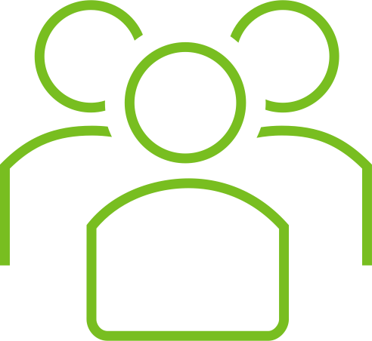
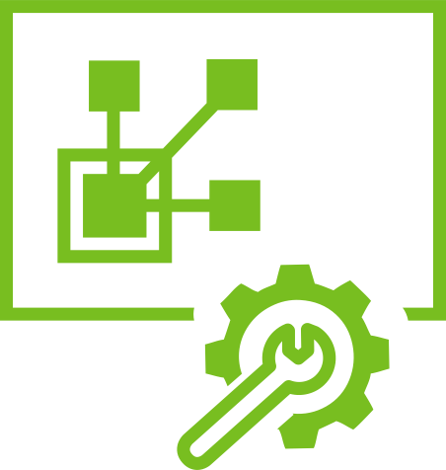



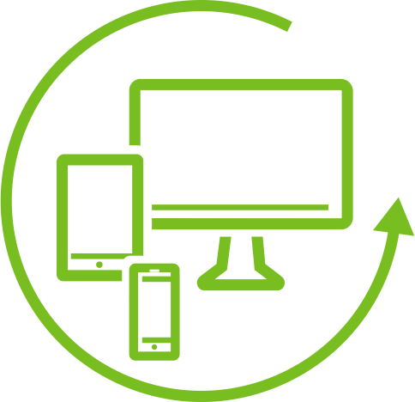

Any Device
Users can work with any app, on any device, from any location
END USERS
IT
Consumer-like experience with easy access to all apps
Simplified app, data, and
device management
Notes:
When it comes to consuming those apps, you’re also focused on enabling users to consume them anywhere, anytime, on any device.
You want to give employees the choice to work where and how they work best, with their favorite tools.
Because you know great employee experiences can help you attract and retain the best talent, drive deeper engagement, and increase productivity.
In fact, in a recent Forbes study, 87% of CIOs surveyed indicated their belief that digitally empowering their employees can drive at least 5 percent additional revenue growth over 3 years.¹
And so, taking advantage of today’s cloud-based management, you’re using digital workspaces to deliver self-service, out-of-the-box experiences to end users, scaling across platforms, locations, and device-ownership models.
Building on our virtualization expertise, we’ve developed a digital workspace solution establishes a new engagement model between IT and end users.
It assumes that users, their devices, and many of their apps are beyond the firewall, requiring a zero-trust approach that protects information with context-aware intelligence and automated remediation.
This approach takes the friction out of app delivery and promotes choice and flexibility while improving security.
You already have multiple security tools is use; however, VMware provides the Trust Network that allows member-security solutions to share contextual data that informs risk and reduces the attack fatigue that stretches your IT and Security resources.
Our solution reduces the complexities of endpoint management across Android, iOS, macOS, Chrome OS, Windows 10, and across established and emerging IoT platforms.
Physical and virtual desktops can be managed side by side, freeing administrators to concentrate on defining and delivering a workspace experience, rather than building images and chasing down patch reports.
Virtual desktops can now take advantage of our Hybrid Cloud infrastructure to run virtual apps or virtual desktop workloads optimized for both employee location or latency from mission critical systems of record.
The digital experiences your employees consume will continue to be a collection of new and legacy apps, physical and virtual, internal, SaaS, and inside and outside the firewall.
Only VMware provides a platform to abstract and shift the complexity of IT and Security away from your employees, providing the consumer-like experiences they expect, and the flexibility and power to do their very best work.
1. “The Impact of a Digitally Empowered Workforce,” VMware and Forbes Insight, 2018. Accessed online at https://www.vmware.com/radius/wp-content/uploads/2018/09/The-Impact-of-a-Digitally-Empowered-Workforce_2017.pdf April 14, 2019.

Slide 9


Modern Apps Are Complex and Distributed
Data Center
SD-WAN
Branch/Edge
IoT Device
Database
VMware Cloud
Microservices
Notes:
Now you have more users on more devices, accessing more apps from more locations than ever.
Apps and data are moving out of traditional data centers—to multiple clouds, to branch offices, to the edge.
And they’re no longer monolithic.
They’re distributed; they’re built using microservices, they’re using data from a variety of sources; they reside across a heterogeneous infrastructure.

Slide 10
Software-Defined Networking Offers Scale and Greater Security
Enabling modern, flexible and secure network services EVERYWHERE
Data Center
SD-WAN
Branch/Edge
IoT Device
Database
Virtual Cloud Network
VMware Cloud
Microservices
Notes:
This means a flexible and secure network is a critical requirement for a digital foundation that supports your apps.
The network needs to be as agile as the business, with the capability to adapt as business and application needs require.
That can only happen in software.
A software-defined networking approach leverages network virtualization—creating a network abstraction in software.
Network virtualization makes it easier to provide a consistent level of connectivity, policy and automation wherever your apps and data reside.
This means interoperability across virtual machines, bare metal servers, and containers, as well as on premises, public cloud, IoT edge devices, or cloud-based services.
We call this the Virtual Cloud Network.
It’s our approach to networking today and into the future as we move from data centers to centers of data.
With the Virtual Cloud Network, you can connect and protect apps and data, regardless of where they reside.
Virtual Cloud Network provides networking consistency end to end; it’s fully defined in software so it’s programmable and automated, and it’s intrinsically more secure than hardware-based networks because security policies sit as close as possible to the app.
This paradigm must extend to the edge as increasingly, customers are building branch and edge sites to be more intelligent, efficient and automated.
With a fully virtualized edge, you can add new applications, cloud-enabled edge services, and network and security services by deploying additional software or simply updating existing policies.
[click]
Software-defined wide area networking (SD-WAN) is a transformational approach that simplifies branch office and edge networking – reducing costs and complexity and assuring optimal application performance.
SD-WAN helps accelerate your business by managing, optimizing, and securing all application traffic from distributed locations to private and public cloud data centers.
An extension of software-defined networking, VMware’s SD-WAN solution (VMware SD-WAN by VeloCloud) enables your organization to provision branch offices and edge locations faster with automated, zero-touch deployment and the ability to insert network services.
SD-WAN also gives you unprecedented control of your network functions with consolidated monitoring and visibility across multiple WAN links and service providers.
Software-defined networking enables powerful automation. Information Technology Intelligence Corp.’s 2018 survey of more than 800 customers worldwide found that 59 percent of respondents cited human error as the No. 1 cause of unplanned downtime.¹
If instead you rely on rules and automation for network configuration, you’re able to streamline operations and reduce operator error.
However, although you need to connect everything, you can’t build flat networks.
It would be a security nightmare.
In today’s distributed app environment, our technology enables you to wrap security as close as possible to each of your apps and components, making it possible to compartmentalize the network through micro-segmentation, ensuring that the app is doing only what it should be doing.
With VMware networking solutions, you’re able to address the needs of your multi-cloud and modern multi-app reality and enable consistent networking and security policies to follow your apps and data across your entire IT environment, from data center to cloud to branch to edge.
1. Information Technology Intelligence Corp.’s (ITIC) 2018 Global Server Hardware, Server OS Reliability Survey (ibm.co/2LCX6gz)

Slide 11
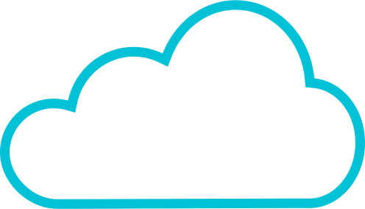
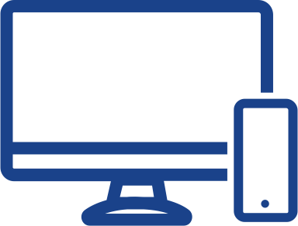
VMware Intrinsic Security
A unique position in your software stack
Intrinsic
Deep App Visibility
Intelligent Automation
Apps
Data
Software-Defined Data Center
User Access Layer
Compute
Network
Data
Users
Devices
Access
More Secure
Infrastructure
Notes:
We’ve touched repeatedly on security.
Traditional approaches to security are complex and rely on too many products.
Too often they focus on blocking threats at the perimeter and are reactive and after the fact.
We believe it’s possible to simplify security; to shrink the attack surface, and to shift from chasing the bad to protecting the known good.
[click]
To do this, security strategy needs to be aligned to your apps and data—and intrinsic to your infrastructure.
We’re in the best position to better secure our customers’ cloud, networking, app and workspace solutions.
We leverage the security capabilities and practices that are already in your software and virtual infrastructure to drastically simplify your security environment with fewer products, and less management and operational overhead.
[click]
Our virtualization software sits in your infrastructure stack or hybrid cloud, in a place where it can give you deeper, unparalleled visibility into your apps and data.
From this vantage point, you can learn an app’s known good behavior in terms of how it interacts with the processor, memory, storage, data and the network, and then you can automate actions based on behavioral anomalies.
This capability enables you to detect a threat like malware, for example, before a malware signature even exists.
We also understand the apps you’re running – and known end-user interactions and behaviors across devices.
[click]
Our intelligent automation allows us to streamline and operationalize security in ways that are very difficult from other vendors to do. We can define policy, enforce, and remediate in dynamic ways that follow whatever your apps and users are doing.
Intrinsic security enables a more proactive approach to threat management. Rather than adding complexity, we simplify security by leveraging your existing software infrastructure and end points and enabling you to attach security to your apps and data.
This in turn enables you to shift from a legacy security model, where you reactively block or ineffectively chase the bad, to a stronger approach to security, where you enforce the known good.

Slide 12
How VMware Helps
CREATE NEW VALUE
DELIVER EXCELLENT EXPERIENCES
PROTECT BRAND AND CUSTOMER TRUST
Accelerate the Cloud Journey |  |  | Transform Networking and Security |  |  | Deliver Secure Digital Workspaces
Notes:
At the end of the day, you want to create new value, deliver excellent experiences, and protect brand and customer trust.
VMware’s cloud, networking, security, and digital workspace solutions work together to enable a foundation that empowers you to achieve your digital business objectives.
We help in three key ways.
We help you accelerate your cloud journey and embrace a cloud operating model across IT, while getting the most out of the private, public, and hybrid clouds of your choice.
We help you transform networking and security, from data center to cloud to branch to edge, to build flexibility, agility and cyber resilience for your business.
And we help you deliver secure digital workspaces that empower employees to do their best work, transform customer experiences, encourage process innovation, and improve engagement across your business ecosystem.
We’re delivering the technology you need tomorrow, building on the technology you have today.
Contact us to learn how we can help you evolve your technology strategy.

Slide 13
Thank You

Slide 14
Innovate in Everything
Notes:
More than any other aspect of our business, our values define us. They are the single most lasting thing we do.
It’s very gratifying to see this come through loud and clear (once again!) in our Voice of VMware survey results. Our values are important across every region, every business unit, and every function.
Each of the five elements in EPIC2 are important in how we operate as a business and how we show up every day as individual employees.
We encourage our employees to innovate in everything across all these areas. Innovation is underpinning all of these values.
[click for build to “Innovate in Everything.”]

Slide 15
Our goal is to give our customers the digital foundation they need for their unique digital transformation journeys.
It’s working. As companies leverage our innovative technologies, they’re driving new results for their businesses, their customers, and their communities.”
Pat Gelsinger, CEO, VMware
Notes:
It may feel like the pace of technology disruption and change these days is so dizzying that it could not possibly get any more intense. But it will. And we’re here to help.
Our goal is to give you the digital foundation you need: one that helps you continue to absorb and benefit from technology innovation and drive the business outcomes you want now and in the future.
We look forward to working with you.
Thank you!

